Slide 1
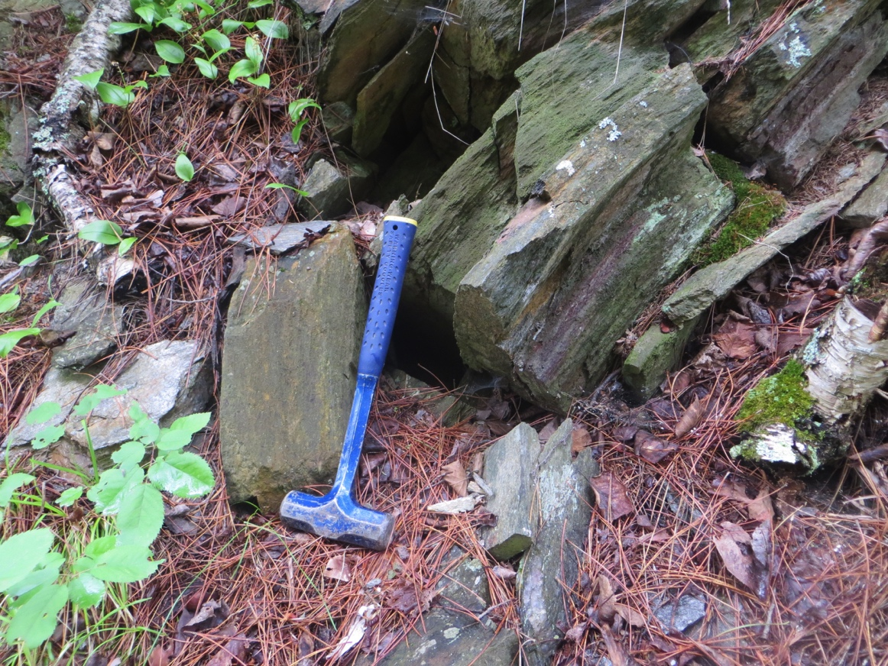
Physical Sample Management Training
Type of samples
Module: Rock Outcrop
Coral
Rock Core
Rock Outcrop
Soil Core

Slide 2
Rock Outcrop
Collection
Processing
Management
Part I
Rock Outcrop Sample Collection

Slide 3
Rock Outcrop
Collection
Processing
Management
Rock Outcrop Sample Collection
Outline of this section:
  Rationale for sampling
    What are your field objectives?
    What about “old” samples?
  Protocol for sample collection
    Collecting the sample
    Collecting the right information
    Incorporating existing samples (“previously collected”)
  Protocol for Sample Information Synthesis
    Preparing for IGSN Registration

Slide 4
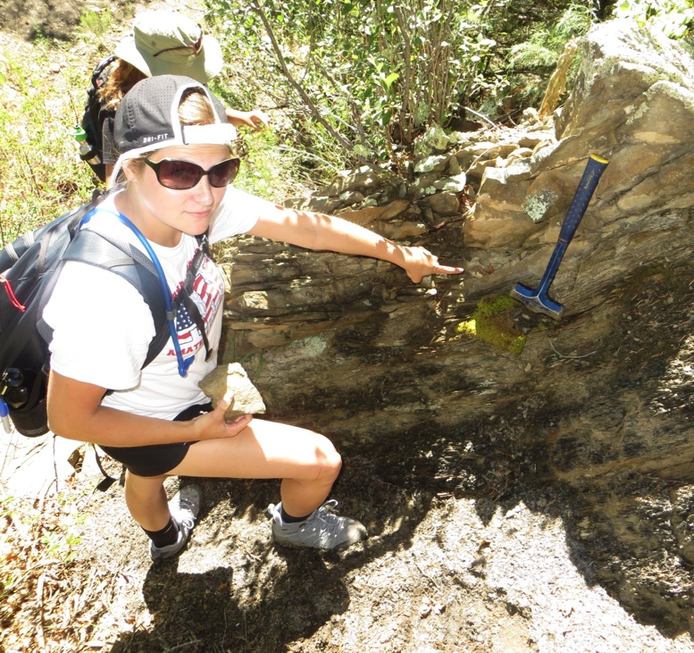
Rock Outcrop
Collection
Processing
Management
I. Rationale for sampling:
“Field Based” metamorphic petrology and tectonics studies go through several stages of planning before field work commences. There are several types of field campaigns that yield samples:
  Reconnaissance Field Sampling
  Targeted Field Sampling
  Acquisition of samples from collaborators / other sources (field work done by others).

Slide 5
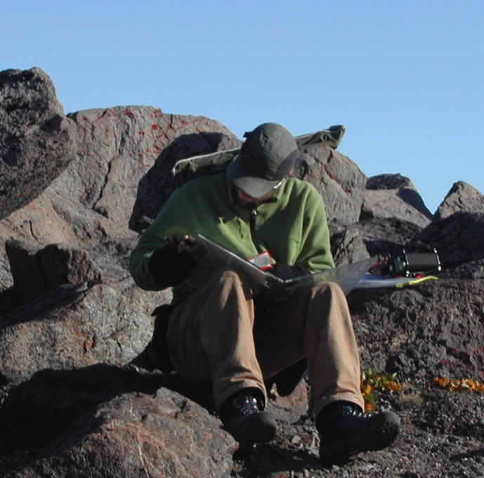
Rock Outcrop
Collection
Processing
Management
Reconnaissance Field Sampling:
unmapped or large-scale mapped areas
Samples to be representative of different lithologies,
  may be mixed in terms of collection purpose and type of derivative data
Collection is more for coverage and regional geologic interpretation, or to represent important field relationships.
For example, igneous intrusions may be sampled, unconformable sedimentary rocks, and perhaps metamorphic rocks of different protoliths/compositions, though these could be less useful in studies of specific metamorphic processes conditions.

Slide 6
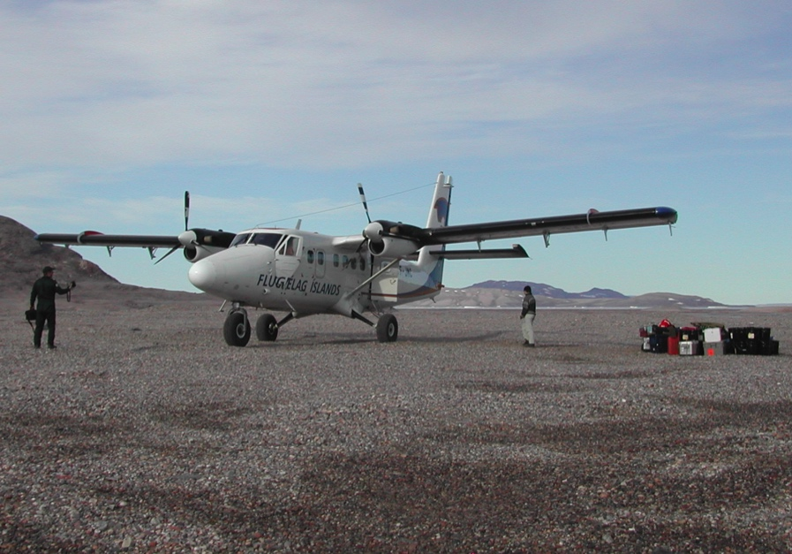
Rock Outcrop
Collection
Processing
Management
Reconnaissance Field Sampling:
A large variation of sample density and size of a suite is possible in such a scenario, often reflecting:
costs of sample processing
payload constraints
viability of performing useful analyses
personal preference/philosophy
It is possible/likely that “targeted” field sampling type study can be performed or derived from a subset of such a reconnaissance mapping/survey. If sample suite size/density permitted sampling lithologies deemed useful for specific purposes (key field relationships or representative composition, mineralogy, metamorphic grade) meaning this type of field campaign can serve multiple purposes.

Slide 7
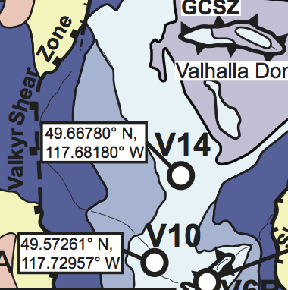
Rock Outcrop
Collection
Processing
Management
Targeted field sampling of previously mapped areas:
This type of field survey typically is focused on an area that has previously had detailed mapping and likely sampling performed
Sample density is likely highly variable because specific lithologies or field relationships are targeted and sampled in greater density
Sample density still must depend in part on:
costs of sample processing
payload constraints
viability of performing useful analyses
personal preference/philosophy
This sampling may be combined with
  detailed mapping at very fine scales
  to represent field relationships.

Slide 8
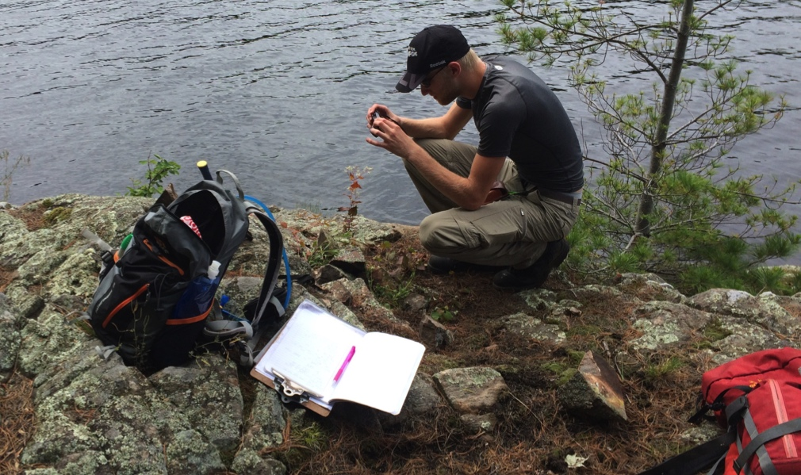
Rock Outcrop
Collection
Processing
Management
Student considerations: Identify the type of field work they are performing and consider why samples are to be collected.
Will there be a specific question guiding field work or will a more broad question of regional geology be the focus?
  This may be the best way of considering appropriate sample density, and basically how to budget time in the field—a major challenge for new (and experienced) geologists.

Slide 9
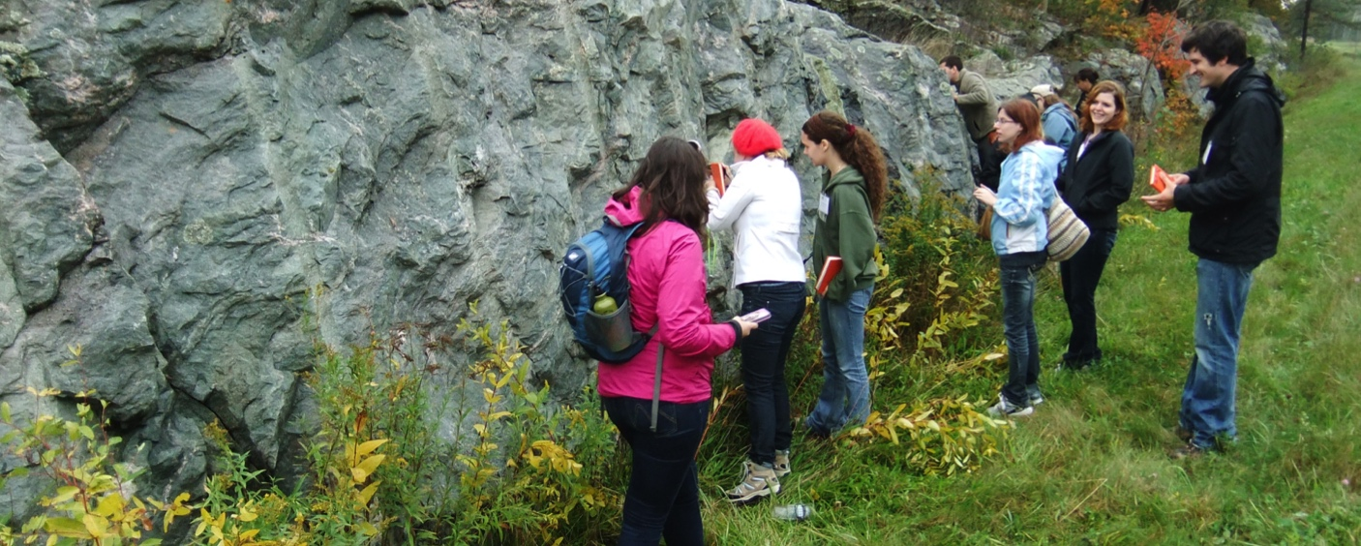
Rock Outcrop
Collection
Processing
Management
Student considerations for undergraduate students:
  it is likely that fieldwork is in part a learning experience where active research is combined with educational learning activities: learning to make measurements, sketches, interpretations, etc.
  In this situation, it is important to be aware of what aspects of the fieldwork are most critical to the research project and its goals/purpose.

Slide 10
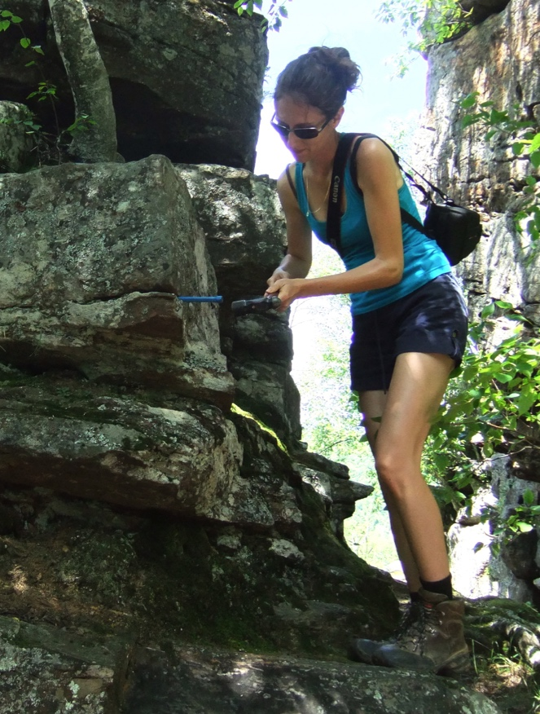
Rock Outcrop
Collection
Processing
Management
II. Protocol for Sampling:
Choose a sample naming protocol for your own organization. Consider a naming scheme that makes sense to others. This is largely a personal preference, but it is worth planning ahead.
Identify the sampling site. Key considerations include:
  Coverage: are you in a location that would have significance in your study area?
  Rock type: Can you reasonably identify what you will sample and is it appropriate for further analysis (is there an intended purpose)?
  Availability of a sample: can you actually collect an in-place sample here?

Slide 11
Rock Outcrop
Collection
Processing
Management
Protocol for Sampling: (continued)
3. Record notes about where, by whom, and when sampling was performed.
Also helpful is information about other features that would aid someone to find this exact site (trees, paths, road names, buildings, etc.)
Use a GPS for the specific sampling location (within 1 meter). Record Latitude/Longitude in notes (in addition to your GPS device-- It is best to have a written backup).
Measure and record any structural data to associate with the sample.

Slide 12
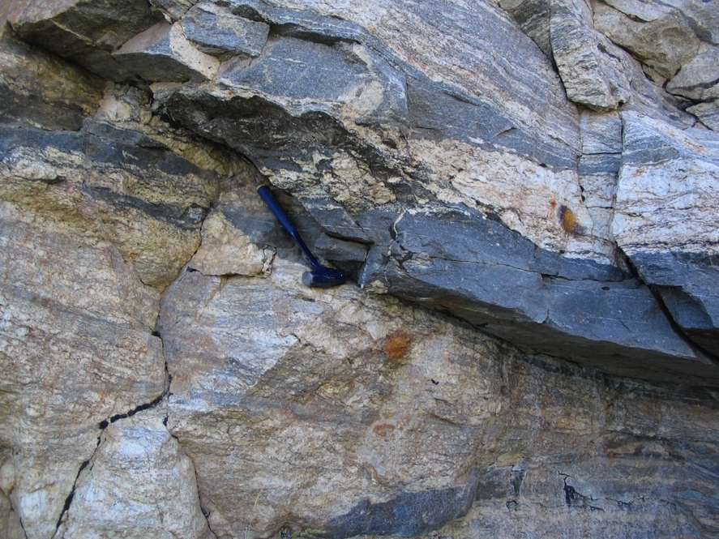
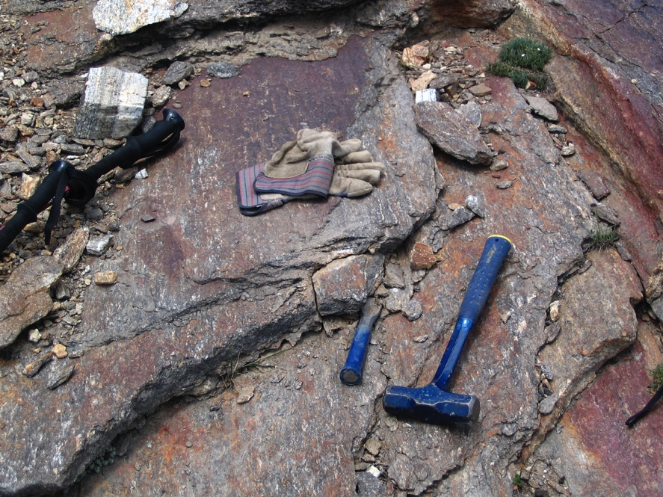
Rock Outcrop
Collection
Processing
Management
Protocol for Sampling: (continued)
4. Photograph the sample site, keeping notes about the filename for the photos. Be sure to include a representation of scale. If you have additional photos/observations from the same site you sample, record these as well in the same place.
Blue rock hammer is ~20 inches in length.

Slide 13
Rock Outcrop
Collection
Processing
Management
Protocol for Sampling: (continued)
5. If you are interested in microstructures, follow steps to collect an oriented sample.
6. Carefully break off an intact rock sample. Assess whether the removed sample meets your criteria for a viable sample. If possible, return the sample to its original site/orientation and photograph it in place. This is particularly important if the sample represents any key field relationships (you may not know at this point, so all the better to be prepared).

Slide 14
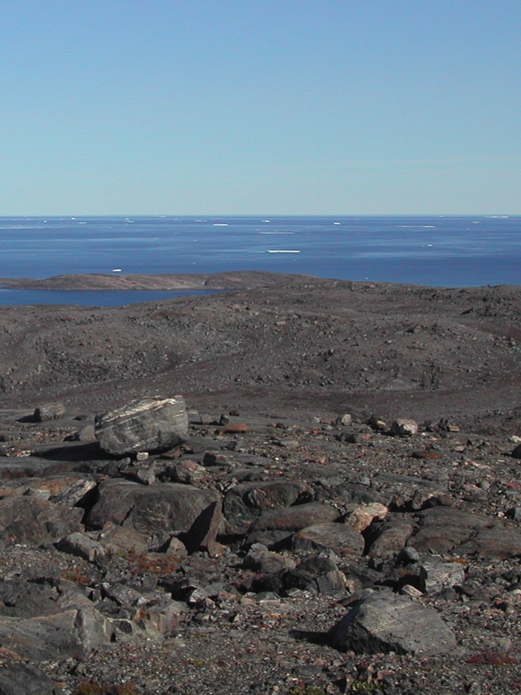
Rock Outcrop
Collection
Processing
Management
A word about float sampling: Float is to be avoided as one can’t be certain it is in place.
The only times to consider float sampling would be:
Float exactly matches the adjacent outcrop in terms of lithology and you would not be able to sample the outcrop for other reasons.
Float rocks present an opportunity to study a process that is not represented in outcrop, and is decoupled from regional/local geology.
Float represents the only “exposed” rock in an area of significant relief that was not likely glaciated or modified by humans.

Slide 15
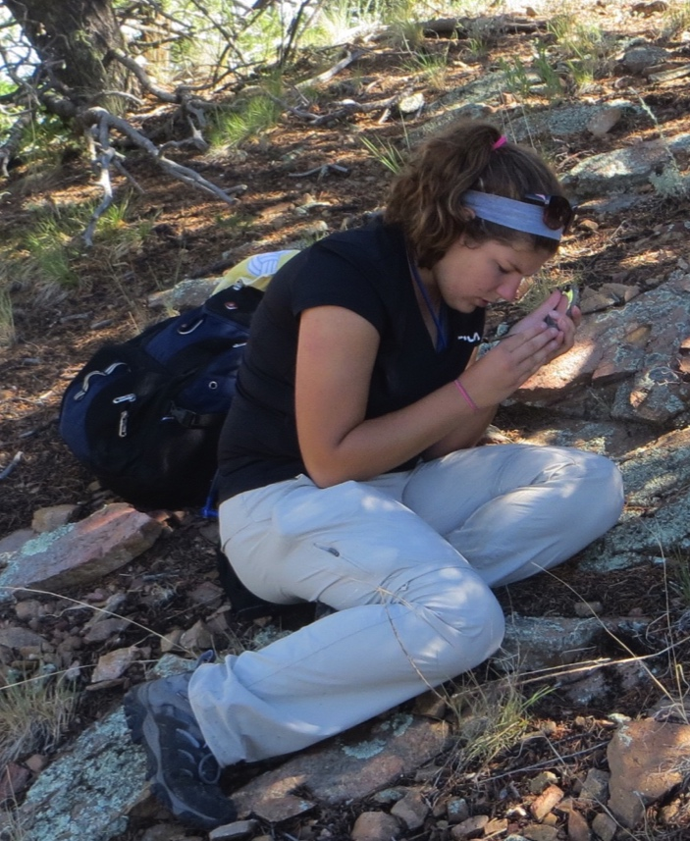
Rock Outcrop
Collection
Processing
Management
Protocol for Sampling: (continued)
7. Label the sample with your chosen sample number, in 2 or more places using a blue or metallic sharpie (these are more visible on earth-toned rocks, especially when wet—avoid black sharpie).
8. Modify your sampling notes to reflect the samples you collect and actually keep. If you discard samples after naming them, do not go back to fill in numbers in your naming scheme (there will always be samples that do not survive through collection, processing, archive, etc.) This way your incremental sample number scheme will be a chronological order as well.

Slide 16
Rock Outcrop
Collection
Processing
Management
Protocol for Sampling: (continued) Previously Collected Samples
Acquisition from other Investigator or Collaborator
  Field work performed in the past, samples shared with documentation
  Sample information may be thorough/complete or more likely partial (due to different sampling protocol or management philosophy)
Protocol for Incorporating samples effectively into workflow:
Gather all sample information. Consider what is preserved/available and what may take effort/time to obtain.
Are the samples already registered with IGSN’s? If so, request and download sample information.
Otherwise, prepare sample information for upload to create IGSN’s for these samples.

Slide 17
Rock Outcrop
Collection
Processing
Management
III. Protocol for Sample Information Synthesis:
1. Beginning with your sample information spreadsheet from the field, copy the worksheet to a new sheet and modify the column headers to be read by the IGSN system. Be sure the following columns are included (some required by SESAR):
Sample Name
Collector
Latitude
Longitude
Collection Date
Comment
Rock Type
→field name (informal classification)
State/ Province
Locality
Location Description
Country
Metamorphic Grade
→Comment
Present Sample Location
→Current Archive
Add necessary columns for IGSN (consult the SESAR Quick Guide):
Navigation Type = GPS
Sub-Object Type = Specimen
Collection date precision = day
Classification = Metamorphic
Material = Rock

Slide 18
Rock Outcrop
Collection
Processing
Management
III. Protocol for Sample Information Synthesis:
2. Download a Batch Registration Template from SESAR, which contains necessary formatting. Paste all information in to SESAR formatted spreadsheet for upload.
Choose public samples
Give yourself a week before samples appear in searches
Choose the fields as listed above
Note: If sample information is to be uploaded to another database system such as MetPetDB, consider a common format for consistent sample metadata.

Slide 19
Rock Outcrop
Collection
Processing
Management
III. Protocol for Sample Information Synthesis:
Check with your supervisor as to which account will be the owner of the sample information. Obtain a login for the owner account or clarify whether you should use a personal login (and perhaps transfer ownership to your supervisor—see SESAR documentation).
3. With a completed/saved batch upload file, login to the appropriate SESAR account.
4. Correct any errors in the preview system and download the updated file to remain current. Make this file a worksheet in the spreadsheet of your sample information and field data.

Slide 20

Rock Outcrop
Collection
Processing
Management
III. Protocol for Sample Information Synthesis:
5. Once IGSN’s are assigned for each sample, update the field sample data spreadsheet for this batch with IGSN’s.
6. Print QR Code stickers for the registered samples from SESAR.
7. Prepare the sample data spreadsheet to upload sample information (including IGSN) to MetPetDB, the database for Metamorphic Petrology: www.metpetdb.rpi.edu
8. For information about preparing sample data for MetPetDB, see the user help information.

Slide 21
Rock Outcrop
Collection
Processing
Management
→ Putting New Samples away in the lab:
IGSN and MetPetDB registered samples should next:
move on to the sample processing (Thin Sections) step.
or
be stored in the sample cabinets with prepared ziplock bags and IGSN QR code stickers or tags.

Slide 22
Rock Outcrop
Collection
Processing
Management
Part II
Rock Outcrop Sample Processing

Slide 23
Rock Outcrop
Collection
Processing
Management
Rock Outcrop Sample Processing
Outline of this section:
Rationale for processing
  What are your objectives?
  What will be done with your samples?
Protocol for sample processing
  Preparing the sample for thin sections
  Preparing the sample for rock chip or grain mounting
  Preparing the sample for mineral separates

Slide 24
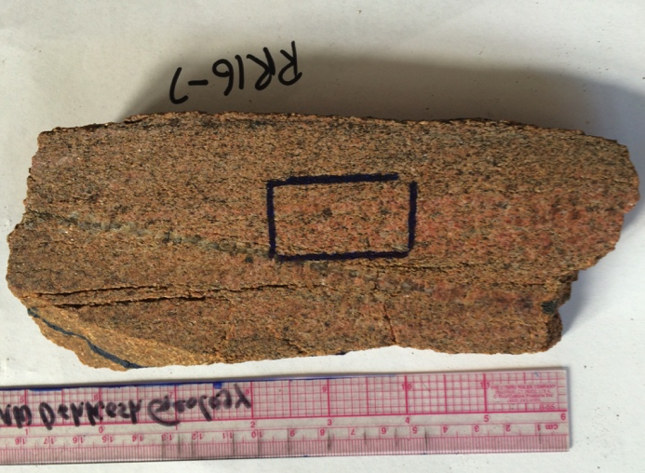
Rock Outcrop
Collection
Processing
Management
I. Rationale for sample processing:
Samples acquired/collected in the field should be categorized by the type of data to be acquired from them. Before beginning sample processing, samples should be prioritized as time and cost constraints on contracted external lab work may be limiting.
  Preparing Thin Sections
  Preparing chip/grain mounts
  Preparing mineral separates to eventually be mounted for analysis.

Slide 25
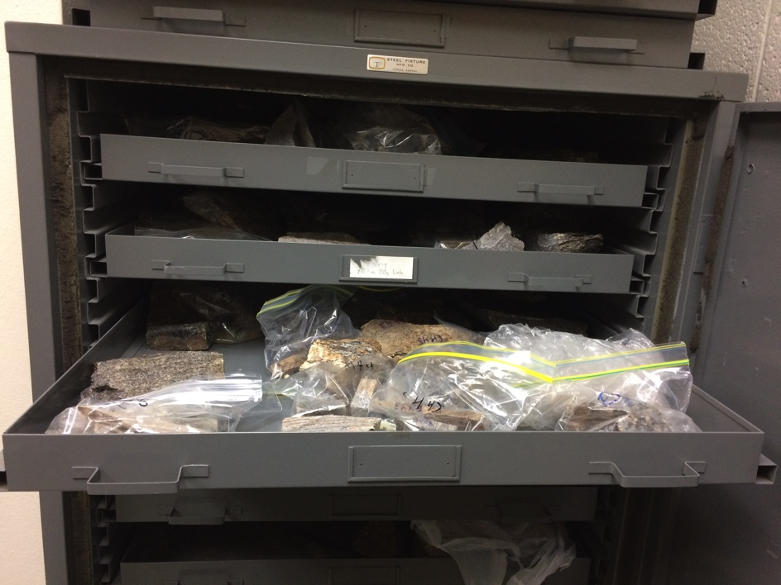
Rock Outcrop
Collection
Processing
Management
II. Protocol for Sample Processing: Thin Sections
Samples to be processed for thin sections are removed from the sample cabinets and placed on the rock cart.
  Before cutting samples, prepare a labeled ziplock bag with sample number and its’ IGSN sticker attached.
    Put all derivative pieces of sample in this bag unless they are thin sections, mounts, or separates.

Slide 26
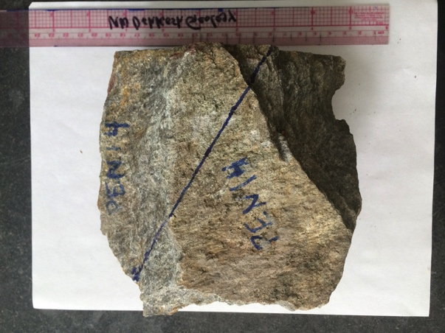
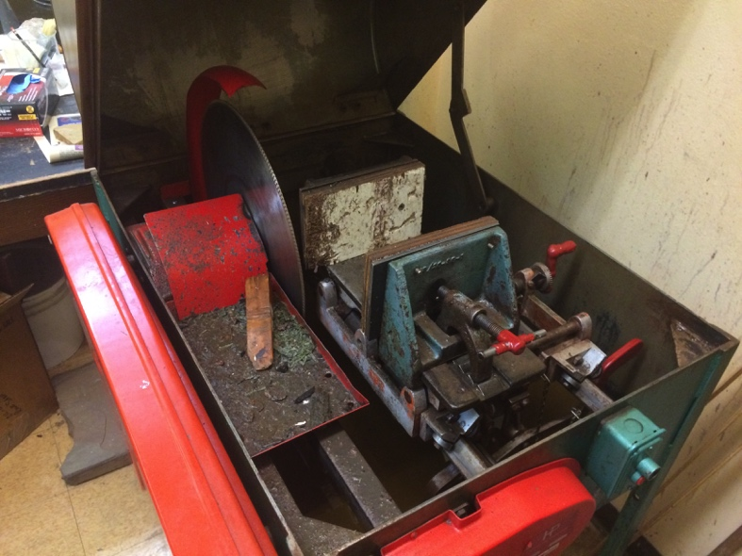
Rock Outcrop
Collection
Processing
Management
Processing rock outcrop samples: Thin Sections
Choose a thin-section orientation for cutting a slab from your sample. Typically a lineation-parallel, foliation-normal cut is preferred.
  Draw the planar intersection along the surface of your sample. Be sure you are making as large a slab as possible.
  Cut slab using auto-feeding saw or tile saw.
  Soak in soapy water to remove any cutting oil.
  Dry in warm oven (~60ºC).

Slide 27
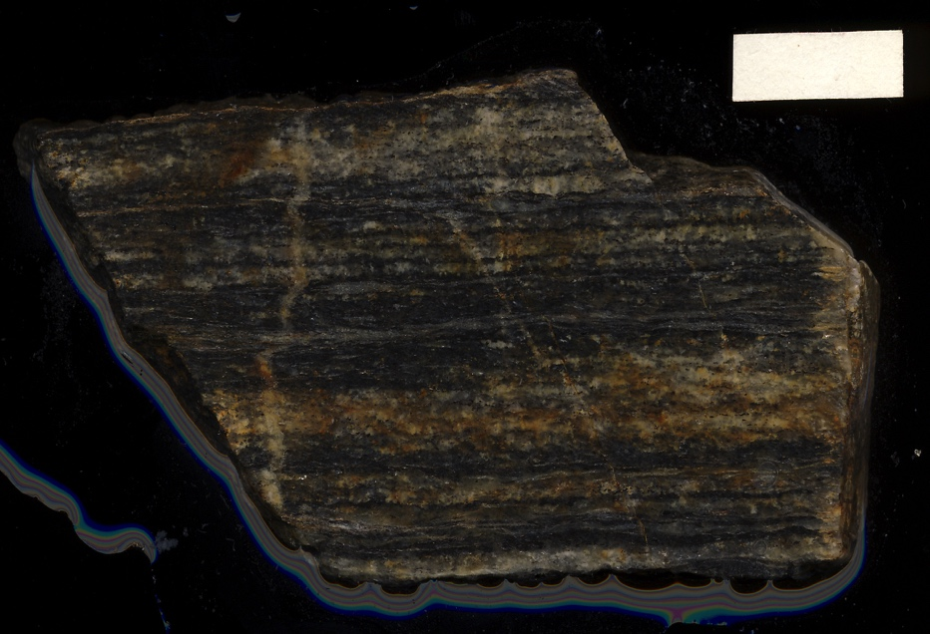
Rock Outcrop
Collection
Processing
Management
Processing rock outcrop samples: Thin Sections
Scan wet slab on flatbed scanner, at a minimum of 600 dpi.
  Be careful with water on the scanner, dab any excess water and clean the glass platen after use.
Choose and mark thin section location. Document this location on slab scan images.
Detailed slab scan. Scale bar is 2cm

Slide 28

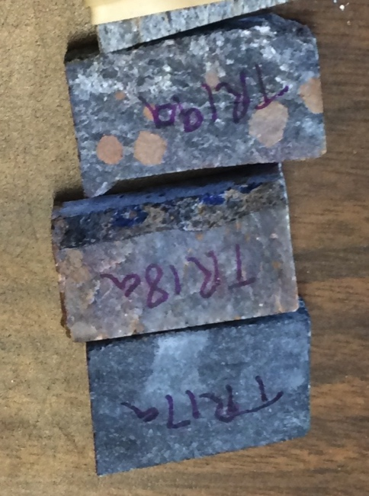
Rock Outcrop
Collection
Processing
Management
Processing rock outcrop samples: Thin Sections
Trim slab to desired billet for thin section. Save all trimmed pieces to return to the sample bag with IGSN label.
Slab is ready for trimming to billet.
Label dry billet on back side with blue Sharpie. Use thin section naming convention: “Sample Number” + a, b, c…

Slide 29
Rock Outcrop
Collection
Processing
Management
Part III
Rock Outcrop Sample Management

Slide 30
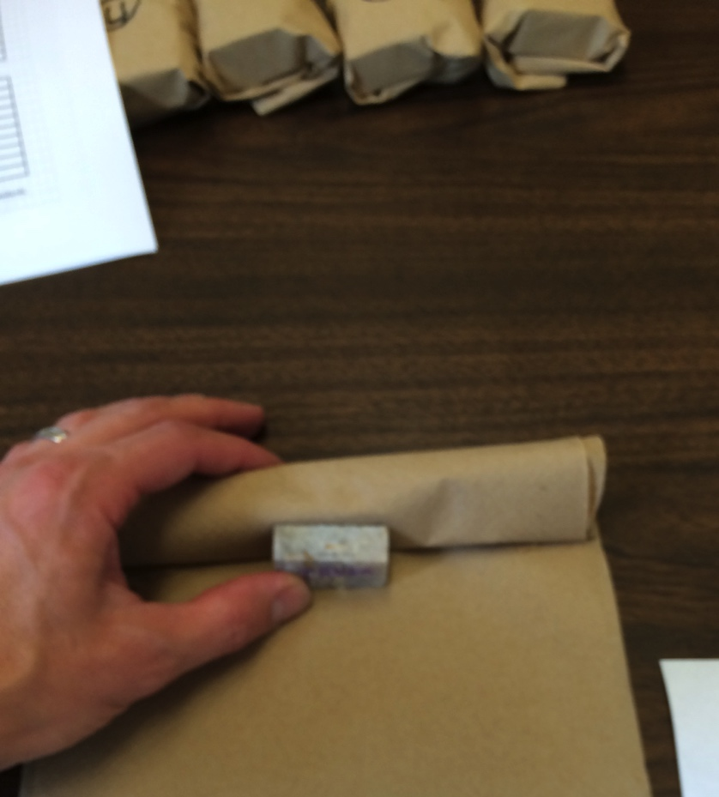
Rock Outcrop
Collection
Processing
Management
Processing rock outcrop samples: Thin Sections
Choose set of billets for thin section processing. Compile a list on a thin sections (tracking) worksheet in your sample management spreadsheet file for this sample suite.
Carefully wrap billets, box them with a lot of bubble wrap, and ship out for thin section preparation.

Slide 31
Rock Outcrop
Collection
Processing
Management
Rock Outcrop Sample Management
Outline of this section:
Rationale for sample management
  What are your objectives?
  How will samples and sample information be properly managed?
Protocol for sample management
  Sample Activity Codes
  Storage of thin sections and other sample material for inactive suites
  Local archiving of inactive sample suites
  Samples from the collection that are off-site

Slide 32
Rock Outcrop
Collection
Processing
Management
Rationale for sample management
Statement of Philosophy:
Physical samples are the basis for field-based geologic and petrologic study. To the investigator, samples represent the ability to make laboratory observations that are impossible in situ, and they should be treated as the sensitive “currency” of geology.
Time and effort managing a growing collection of samples means preserving this currency, and investing in its potential in the future. As much as scientific inquiry is built upon the past discoveries in our field, our investigative power is greatly strengthened by being able to return to the original source of our detailed analyses—our samples. With the swift advance of analytical power it should be clear that the future holds new ways of exploring information stored in our sample collections.
Samples collected as part of publicly funded research belong, in part to the public, and therefore should be ultimately available.

Slide 33
Rock Outcrop
Collection
Processing
Management
Rationale for sample management:
What are your sample management objectives?
Help our own research team/collaborators be more efficient in dealing with samples, from collection, through analysis, publication, and archiving
Make our sample collection accessible.
Track and locate samples and subsamples (on site and off site) at different stages of use.
Ultimately, to preserve the usefulness of a given sample, particularly for applications that may not have been considered.

Slide 34
Rock Outcrop
Collection
Processing
Management
Rationale for sample management:
How will samples and sample information be properly managed?
A sample management protocol is presented for Rock Outcrop samples.
Samples entering the lab workflow will follow the protocols for
  Sample collection and documentation
  Sample processing (preparing for and performing analysis)
  Sample management (storing, tracking and archiving)

Slide 35
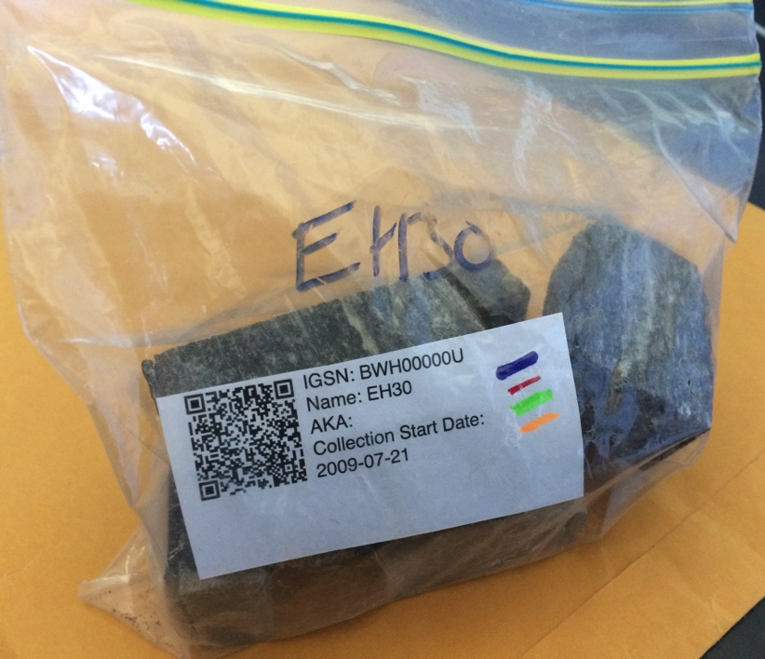
Rock Outcrop
Collection
Processing
Management
II. Protocol for Sample Management
All samples in the lab are managed with an simple activity code.
Activity Codes:
Cut
Examine
Analyze
Store
Archive
Teaching
Out
Activity coding for processed samples can be tracked on the IGSN QR code printout stored with the hand sample.

Slide 36
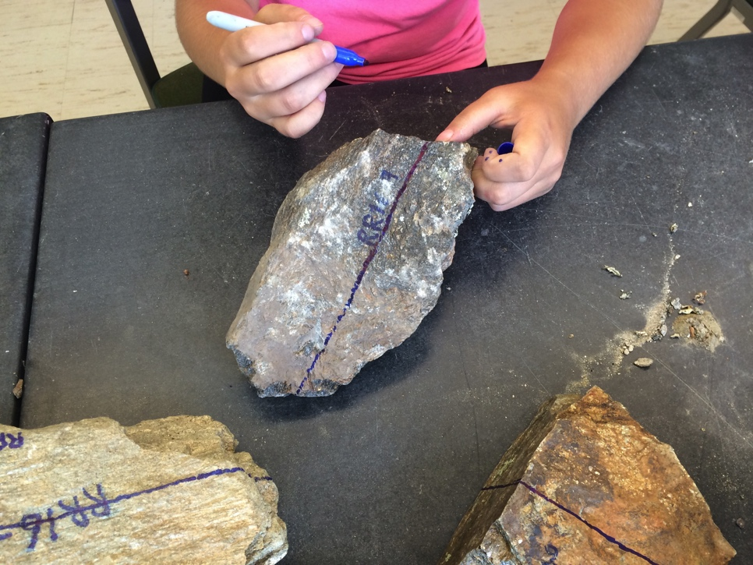
Rock Outcrop
Collection
Processing
Management
II. Protocol for Sample Management
Activity Code Explanations:
Cut: Samples are in the process of being registered with IGSN’s and cut to prepare thin sections or other subsamples. This includes samples with slabs being scanned or any sample not yet having a thin section.

Slide 37
Rock Outcrop
Collection
Processing
Management
Activity Code Explanations:
Examine: Samples now have at least one thin section prepared and are being examined petrographically but have not had any analyses performed.
  These samples exist as (1) the cut pieces of the hand sample or core, plus (2) a thin section(s) stored in lab thin section boxes with their collected batch.

Slide 38
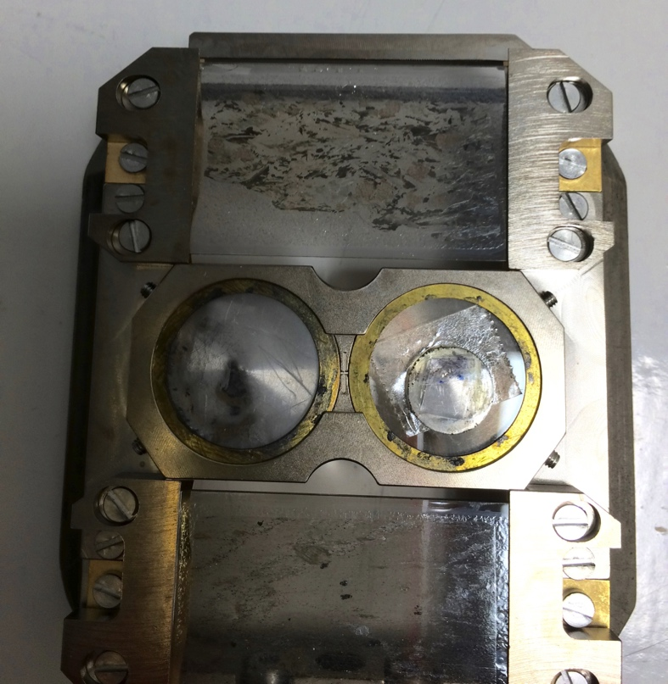
Rock Outcrop
Collection
Processing
Management
Activity Code Explanations:
Analyze: Samples have at least one thin section prepared and are being or have been analyzed by geochemical techniques (e.g. electron microprobe, SEM, LA-ICPMS).
  Polished thin sections may be carbon coated and should be stored with other Analyze Samples that are to be brought to the external lab.
  Analyze samples may be arranged by suite but are separated from the full suites at this stage for analysis

Slide 39
Rock Outcrop
Collection
Processing
Management
Activity Code Explanations:
Store: Work is considered complete on Store samples.
  Thin sections are compiled for the complete suite, including sections that were analyzed.
  The sample material is inventoried and condensed in the labeled drawers in the storage cabinets.
  Storage is considered long-term until archiving is necessary because of space issues.

Slide 40
Rock Outcrop
Collection
Processing
Management
Activity Code Explanations:
Archive samples are to be boxed and moved from storage cabinets to a long term location.
  These samples are collections managed by the local department. The PI is no longer actively doing research.
  Archive samples shall be remain labeled and bagged just as Store samples are, but will be boxed as suites.
  Boxed suites should include a sample inventory list and printed sheet of IGSN QR codes.

Slide 41
Rock Outcrop
Collection
Processing
Management
Activity Code Explanations:
Teaching samples are treated and stored separately from other samples, in teaching collections unless
  These samples are collections managed by the local department. They should not be managed by anyone but instructors.
  Teaching samples may serve two purposes and may also be Archive or Store samples removed from their respective suites and managed as Teaching samples. In this case, special notes should be made in the Archive or Store sample inventories.

Slide 42
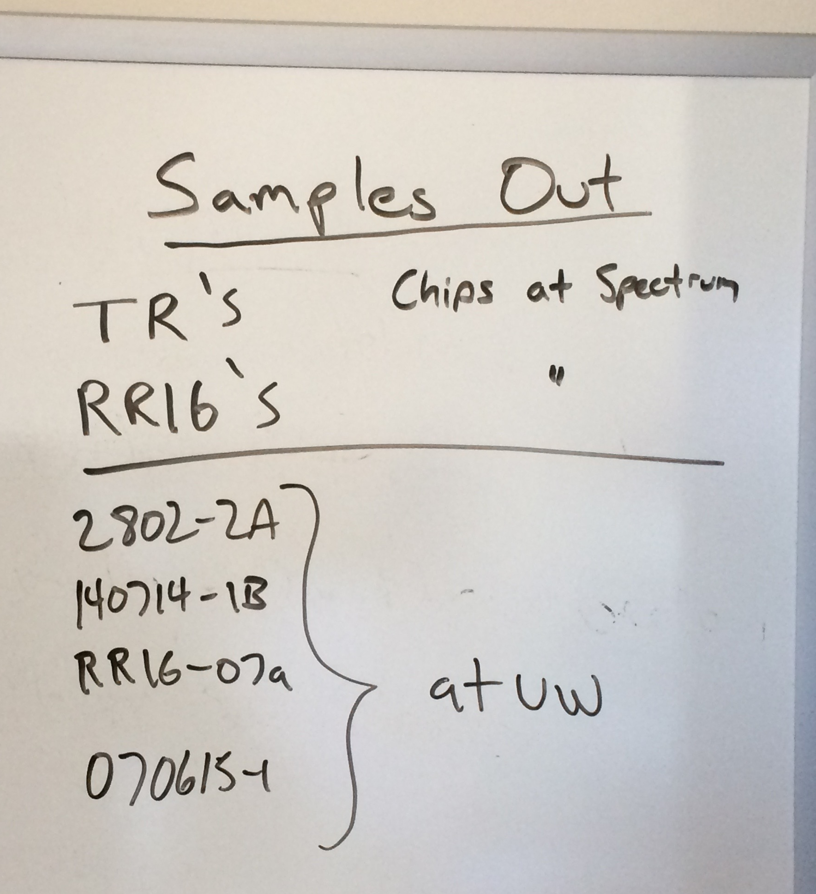
Rock Outcrop
Collection
Processing
Management
Activity Code Explanations:
Out samples are not presently in the collections though they are still considered part of their respective suites. Samples may be sent Out for different reasons, but should be:
  Listed as out on the whiteboard if they come from Examine or Analyze suites.
  Noted on sample inventory sheets if they are out from Store or Archive suites.

